Slide 1
products
Bare Board Probes
ICT Probes
Semiconductor Probes
Customized Probes
High Current Probes

Slide 2
products materials
Products
Plunger
(SK4 , BeCu , Pd Alloy & SUS)
USA
Barrel & Receptacle (N.S. & PhBr)
USA
JAPAN
Spring (SUS & SWP)
JAPAN
JAPAN
Plating (Nickel , Gold , Rhodium & Pd Alloy)
JAPAN

Slide 3
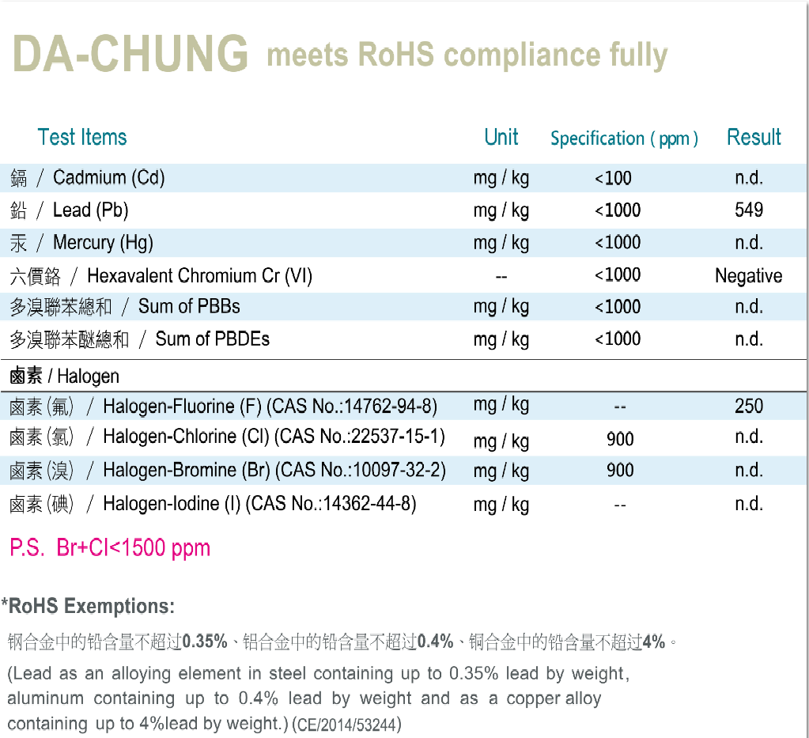
POLICY FOR ENVIRONMENTAL PROTECTION

